Slide 1
Welcome

Slide 2
Predict House Sales Prices Advanced Regression Techniques
By
Baskaran Viswanathan

Slide 3
Problem Statement
How to give a price range to home buyer, by predicting the price, based on the different features of a house, including no of bedrooms, size of the living area, etc.…

Slide 4
Dataset Source
https://www.kaggle.com/c/house-prices-advanced-regression-techniques/data
Dataset Details
The data has 79 explanatory variables describing (almost) every aspect of residential homes in Ames, Iowa, USA.
Records details
Total No of Rows: 1460
Total No of Columns: 80

Slide 5
Data Description
SalePrice
The property's sale price in dollars. This is the target variable
MSSubClass
The building class
MSZoning
The general zoning classification
LotFrontage
Linear feet of street connected to property
LotArea
Lot size in square feet
Street
Type of road access
Alley
Type of alley access
LotShape
General shape of property

Slide 6
Data Description
LandContour
Flatness of the property
Utilities
Type of utilities available
LotConfig
Lot configuration
LandSlope
Slope of property
Neighborhood
Physical locations within Ames city limits
Condition1
Proximity to main road or railroad
Condition2
Proximity to main road or railroad (if a second is present)

Slide 7
Data Description
BldgType
Type of dwelling
HouseStyle
Style of dwelling
OverallQual
Overall material and finish quality
OverallCond
Overall condition rating
YearBuilt
Original construction date
YearRemodAdd
Remodel date

Slide 8
Data Description
RoofStyle
Type of roof
RoofMatl
Roof material
Exterior1st
Exterior covering on house
Exterior2nd
Exterior covering on house (if more than one material)
MasVnrType
Masonry veneer type
MasVnrArea
Masonry veneer area in square feet
ExterQual
Exterior material quality
ExterCond
Present condition of the material on the exterior

Slide 9
Data Description
Foundation
Type of foundation
BsmtQual
Height of the basement
BsmtCond
General condition of the basement
BsmtExposure
Walkout or garden level basement walls
BsmtFinType1
Quality of basement finished area
BsmtFinSF1
Type 1 finished square feet
BsmtFinType2
Quality of second finished area (if present)
BsmtFinSF2
Type 2 finished square feet
BsmtUnfSF
Unfinished square feet of basement area

Slide 10
Data Description
TotalBsmtSF
Total square feet of basement area
Heating
Type of heating
HeatingQC
Heating quality and condition
CentralAir
Central air conditioning
Electrical
Electrical system
1stFlrSF
First Floor square feet
2ndFlrSF
Second floor square feet
LowQualFinSF
Low quality finished square feet (all floors)

Slide 11
Data Description
GrLivArea
Above grade (ground) living area square feet
BsmtFullBath
Basement full bathrooms
BsmtHalfBath
Basement half bathrooms
FullBath
Full bathrooms above grade
HalfBath
Half baths above grade
Bedroom
Number of bedrooms above basement level
Kitchen
Number of kitchens
KitchenQual
Kitchen quality

Slide 12
Data Description
TotRmsAbvGrd
Total rooms above grade (does not include bathrooms)
Functional
Home functionality rating
Fireplaces
Number of fireplaces
FireplaceQu
Fireplace quality
GarageType
Garage location
GarageYrBlt
Year garage was built
GarageFinish
Interior finish of the garage

Slide 13
Data Description
GarageCars
Size of garage in car capacity
GarageArea
Size of garage in square feet
GarageQual
Garage quality
GarageCond
Garage condition
PavedDrive
Paved driveway
WoodDeckSF
Wood deck area in square feet

Slide 14
Data Description
OpenPorchSF
Open porch area in square feet
EnclosedPorch
Enclosed porch area in square feet
3SsnPorch
Three season porch area in square feet
ScreenPorch
Screen porch area in square feet
PoolArea
Pool area in square feet
PoolQC
Pool quality
Fence
Fence quality

Slide 15
Data Description
MiscFeature
Miscellaneous feature not covered in other categories
MiscVal
$Value of miscellaneous feature
MoSold
Month Sold
YrSold
Year Sold
SaleType
Type of sale
SaleCondition
Condition of sale

Slide 16
Initial findings
Total No of Quantitative Features: 37
Total No of Qualitative Features: 39
The Sale price distribution details are
Min Selling Price is: 34900
Average Selling Price is: 180921.20
Median Selling Price is: 163000.0
Max Selling Price is: 755000

Slide 17
Relationships Significant
Feature Name | Percentage of Relationships Significant
MSSubClass | 97.70%
GarageType | 93.00%
Neighborhood | 90.70%
ExterQual | 90.70%
BldgType | 90.70%
Exterior2nd | 90.70%
BsmtQual | 88.40%
Exterior1st | 88.40%
KitchenQual | 88.40%
HouseStyle | 88.40%
BsmtFinType1 | 86.00%
BsmtExposure | 86.00%
MSZoning | 83.70%
Foundation | 83.70%
BsmtFinType2 | 83.70%
FireplaceQu | 81.40%
GarageCond | 81.40%
GarageFinish | 81.40%
PavedDrive | 81.40%
SaleCondition | 81.40%

Slide 18
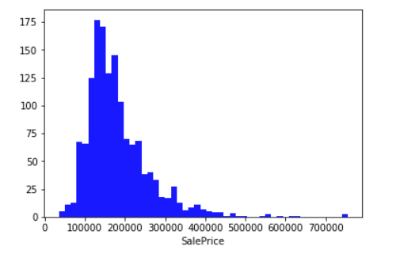
Sale Price Distribution
With this information we can see that the prices are skewed right and some outliers lies above ~500,000.

Slide 19
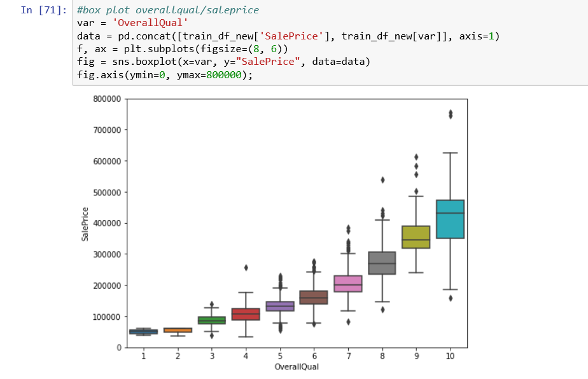
Overall Qualification Vs SalePrice
The OverallQualification Vs SalePrice shows that the Price ranges are from $350000 to $450000.

Slide 20
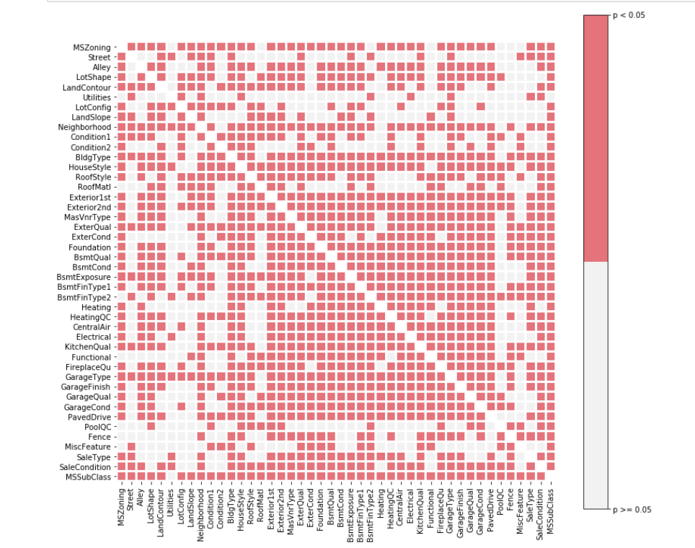
Statistically Significant vs Non-significant

Slide 21
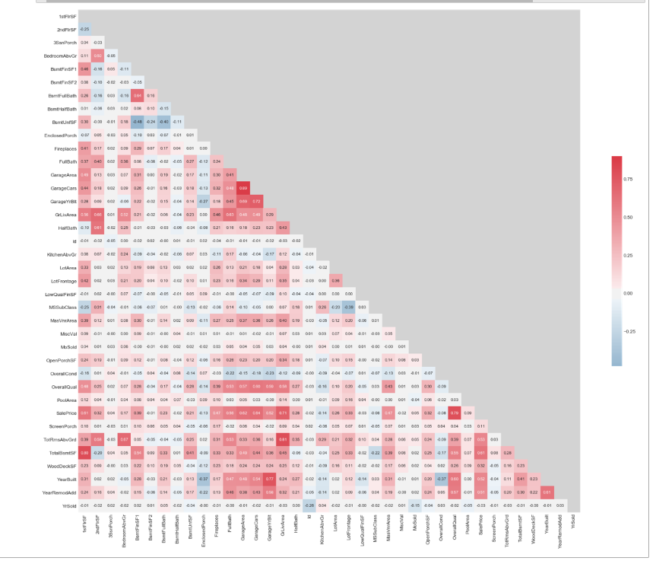
Correlation Matrix - Pearson coefficients

Slide 22
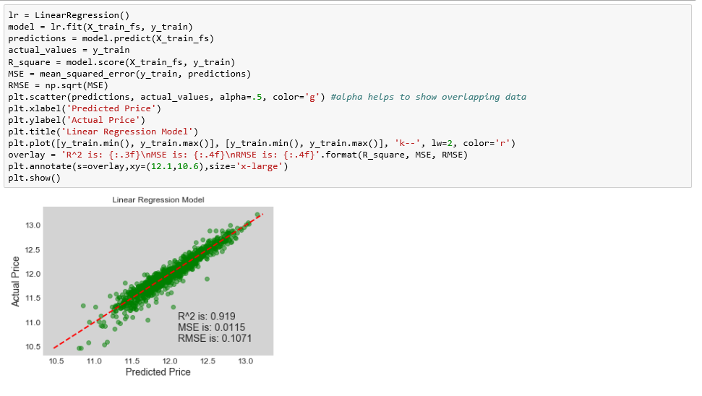
Linear Regression

Slide 23
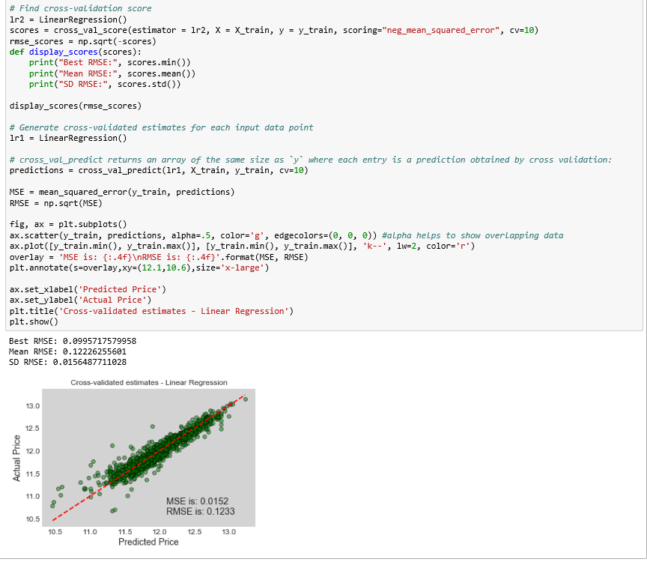
Cross Validation - Linear Regression

Slide 24
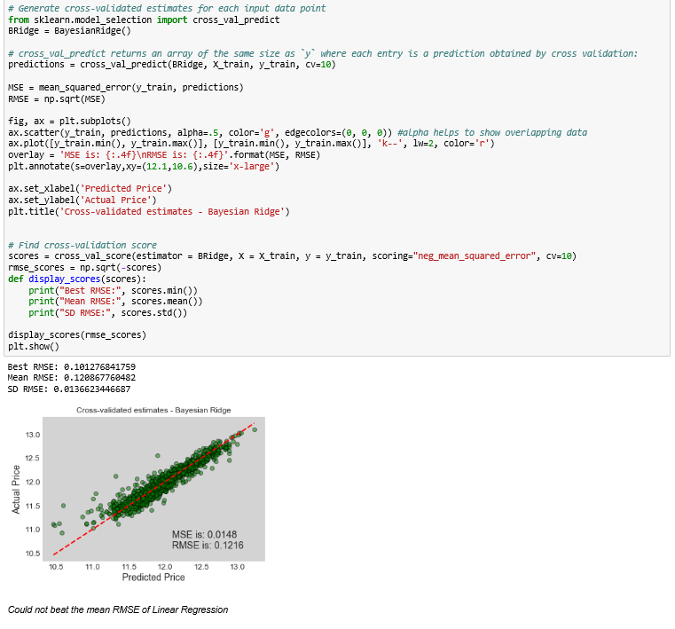
Cross Validation – LR (Bayesian Ridge)

Slide 25
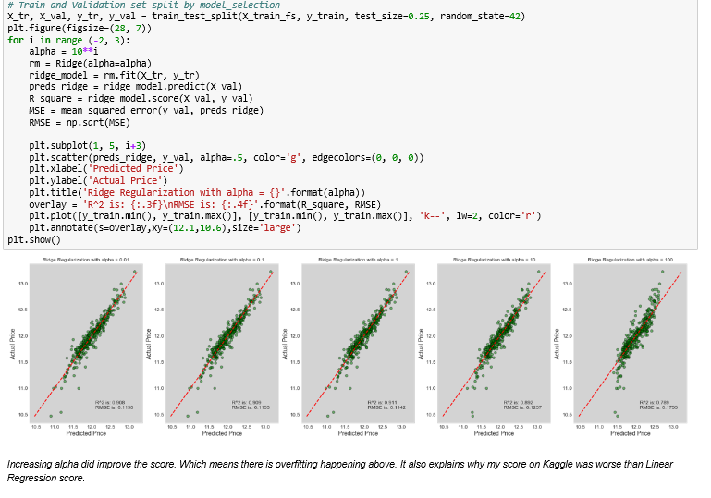
Ridge Regression

Slide 26
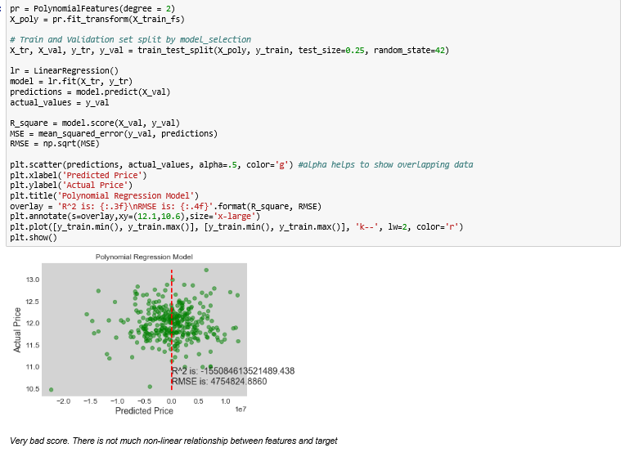
Polynomial Regression

Slide 27
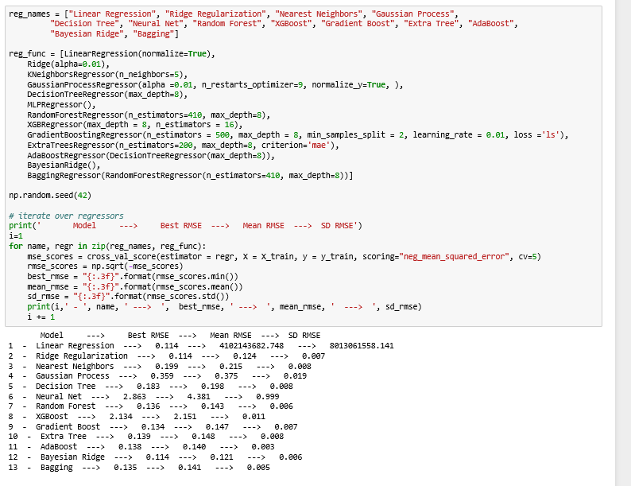
Regression Comparison - Normal

Slide 28
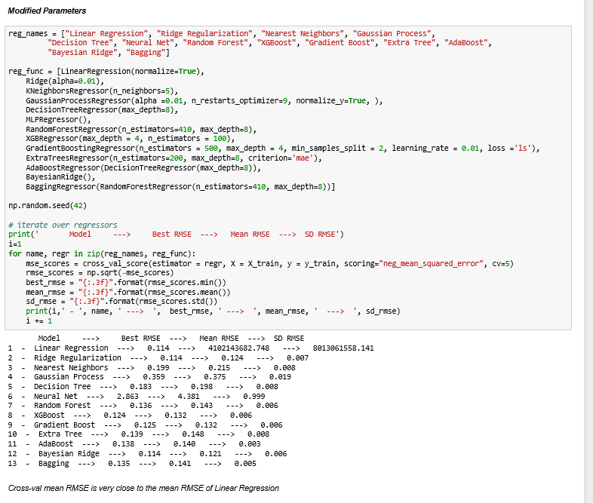
Regression Comparison – Tuned Param

Slide 29
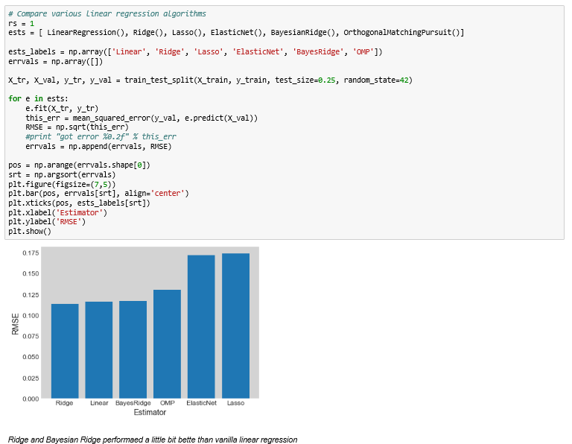
Regression Comparison

Slide 30
Final Thoughts
Normal Regression is doing better than the others
Data is not normally distributed, especially with many missing values.
Need to explore many Other Algorithms
Thinking in different angles, Learning and Practicing is the best way to learn ML

Slide 31
Thank you

